Slide 1

Investigating the Implications of Metaverse Platforms on Higher Education
Omar Fourati, 2249230
Hanna Jobst, 23225014
Magnus Schneider, 22436866

Slide 2
Learning in the Metaverse
Agenda
01
Motivation
02
Study Design
03
Methodology / Individual Contributions
04
Results
05
Limitation
06
Reflexion
9. Februar 2024

Slide 3



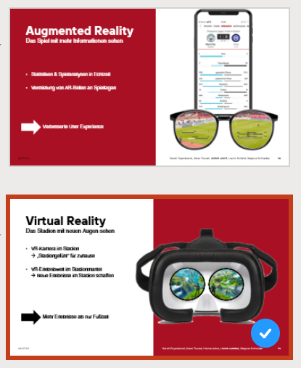
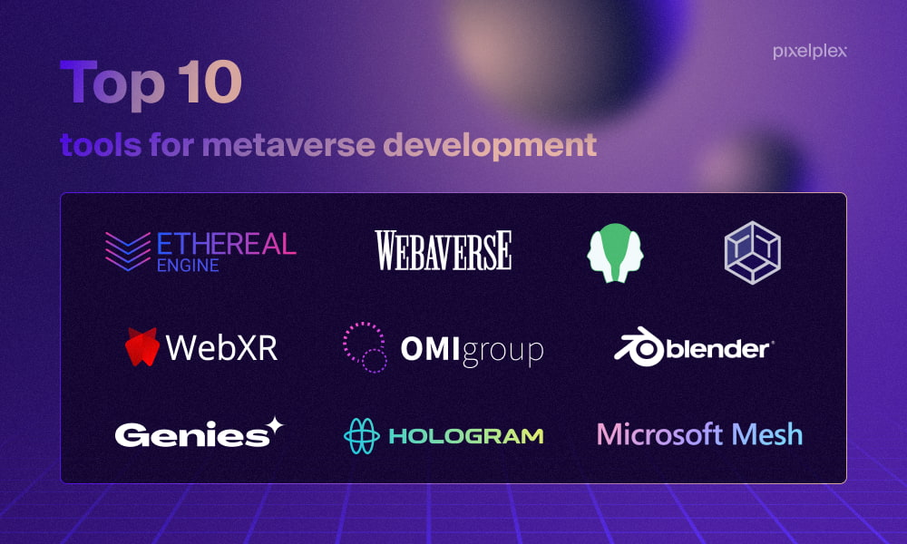

Why the metaverse?
Motivation
$120 billion
Other touching points
Innovation
9. Februar 2024
Notes:
More and more financements for metaverse with meta biggest one
Subject that comes more and more ( ex Club seminar solution proposal …)
Innovation in so much tools and companies that we want to try new things and go beyond limitations for new experiences…

Slide 4



We answered the research question using 3 methods
Study design
„What are implications for the implementation of metaverse solutions in higher education? “
Literature Review
Use Case Analysis
Expert Interviews
9. Februar 2024

Slide 5
Literature Review
Notes:
To structure existing knowledge on the topic the first research method we conducted …

Slide 6



Structured Literature Review
Literature Review - SLA
Structured Literature Analysis (adopted from Kitchenham and Charters by Hericko and Sumak)
Search terms
Libraries
Search query
Relevance
9. Februar 2024
Notes:
3 parts:
Planning, conducting, reporting
→ Setting search terms, libraries and search querys

Slide 7
Defining search terms based on the research question
Search Terms
Search Terms
Libraries
„metaverse“
„learning“
„education“
„higher“
Search query & Relevance
Extraction
9. Februar 2024
Notes:
As well as alternative spelling & synonyms
How to use those search terms properly and screen libraries

Slide 8
Not only scientific libraries hold important information
Libraries & practical sources
Search Terms
Libraries
Science Direct
Scopus
IEEE Xplore
Practical Sources
Search query & Relevance
Extraction
9. Februar 2024
Notes:
However, Metaverse is a trending topic in pop culture as well as relevant for innovative companies.
considered practical source from companies & other projects
Learned → practical sources to include

Slide 9
Metadata was used to get an overview of each paper
Metadata
Search Terms
Metadata:
Title
Abstract
Keywords
Citations
Libraries
Search query & Relevance
Extraction
9. Februar 2024
Notes:
Search query was adapted to cover the metadata such as

Slide 10
Latest pubilcations and educational aspects are relevant
Relevance
Search Terms
Context of education facilities
Recent publications to capture the latest insights
Inclusion of pedagogical models
Theoretical & practical insights
Libraries
Search query & Relevance
Extraction
9. Februar 2024
Notes:
Educational, learning aspects
Latest publications
Paedagogical model consideration
Theory & practice

Slide 11
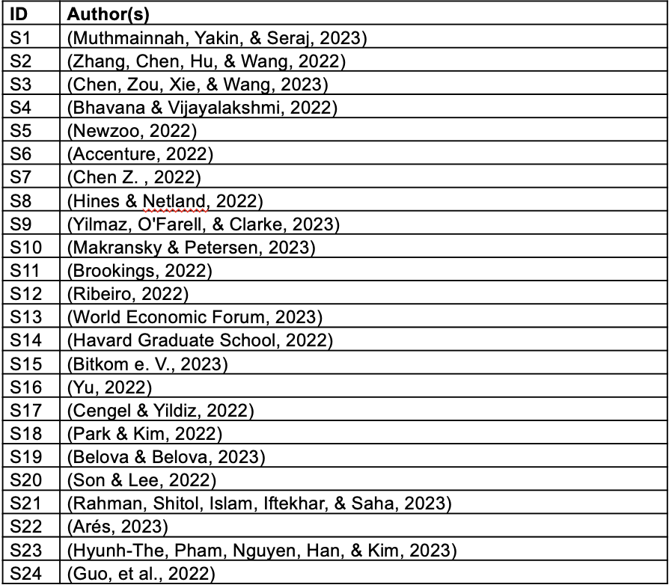
Source with relevant knowledge
Knowledge Extraction
Search Terms
Libraries
Search query & Relevance
Extraction
9. Februar 2024
Notes:
From 24 Studies / sources
a range of perspectives, including academic articles, industry reports, interviews, and podcasts
The knowledge was categorized into 3 categories
Benefits & Potential, Downsides & Obstacles, Future Studies

Slide 12
Use Cases

Slide 13


Basic concepts understanding
Use Cases search
Literature review and key concepts
Comprehensive review: read, ask, look up for information..
Explore academic journals, papers, companies' websites
Search relevant keywords
Filter criteria
Deep understanding of key concepts for optimal search
→ Use cases are an application of all these concepts
Extract the use cases
9. Februar 2024

Slide 14

Search and filter keywords
Use Cases search
Literature review and key concepts
Search relevant keywords
Define which keywords are relevant for the search
Script to look for keywords in found papers
Helpful to automate the search on found websites/papers
Filter criteria
Extract the use cases
9. Februar 2024

Slide 15
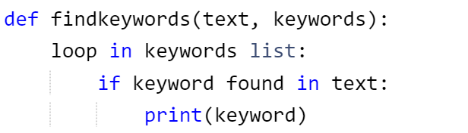
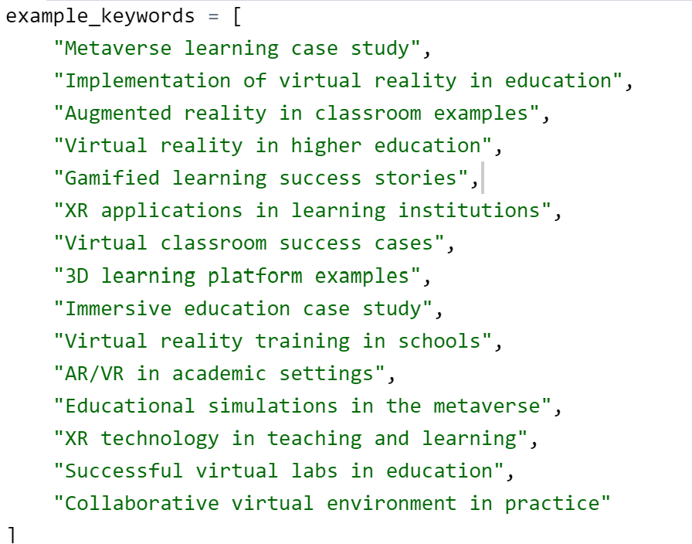
Search and filter keywords
Use Cases search
Literature review and key concepts
Search relevant keywords
Filter criteria
Extract the use cases
9. Februar 2024

Slide 16

Search and filter keywords
Use Cases search
Literature review and key concepts
Search relevant keywords
Investigate further the sources found for final filter criteria:
Is use case/example clear ?
Can the use case/example be documented ?
Tested or used actively with feedback behind it?
Is the pedagogical approach recognizable ?
Able to map it into the created clusters ?
Filter criteria
Extract the use cases
9. Februar 2024

Slide 17

Extract Use Cases from literature
Use Cases search
Literature review and key concepts
Search relevant keywords
Extract use cases with source information
Create a list of all the paper and use cases
Filter criteria
Document extracted use cases
9. Februar 2024

Slide 18

Categorize Use Cases
Use Cases search
Pedagogical approaches
Map use cases to learning startegies
Extract the pedagogical goals and approaches of the developped solutions
Define and analyse trend
Conclude about challenges & solutions
9. Februar 2024

Slide 19
Define the learning strategies
Use Cases search
Pedagogical approaches
Map use cases to learning startegies
Define which approach belongs to which learning strategy
Example: a platform for learning with others => collaborative learning
Define and analyse trend
Conclude about challenges & solutions
9. Februar 2024

Slide 20

Define and document the trends
Use Cases search
Pedagogical approaches
Map use cases to learning startegies
Combine results of each found learning strategy
Conclude on occurency of each
Define and analyse trend
Conclude about challenges & solutions
9. Februar 2024

Slide 21

Define and document the trends
Use Cases search
Pedagogical approaches
Map use cases to learning startegies
Summary and documentation of all solutions
Define challenges, positive aspects …
=> Combine knowledge aquired with literature and expert interview
Define and analyse trend
Conclude about challenges & solutions
9. Februar 2024

Slide 22
Expert Interviews

Slide 23

Define the goals of the interview
Expert Interviews
Define research objectives
Conduct literature review to understand current state of knowledge
Identify gaps or areas where expert insights are crucial.
Select and prepare experts:
Conduct interviews
Create topics/objectives for interviews
Decide over interview type
Develop detailed questions
Analyze and document findings
Gioia et.. al., 2012
9. Februar 2024
Notes:
Gioia, D. A., Corley, K. G. & Hamilton, A. L. (2012). Seeking qualitative rigor in inductive research. Organizational Research Methods, 16(1), 15–31. https://doi.org/10.1177/1094428112452151
→Methodology adapted from this paper
Literature Review: Conduct a thorough review of existing literature to understand the current state of knowledge in the field. Identify gaps or areas where expert insights are crucial.
Define Clear Objectives: Clearly articulate the specific research objectives or questions that the expert interview aims to address. This might involve seeking clarification on a complex scientific concept
Develop Detailed Questions: Craft questions that go beyond generalities, addressing specific scientific concepts, methodologies, and recent developments. Ensure that questions are clear, concise, and encourage in-depth responses.

Slide 24


Prepare the interview
Expert Interviews
Define Research Objectives
Decide on expert groups
Identify relevant experts
Select and prepare experts:
Conduct interviews
Contact experts via different communication channels
Pre-Interview communication
Analyze and document findings
9. Februar 2024
Notes:
Identify Expertise: Choose experts based on their proven track record, publications, and experience in the relevant scientific domain.
Pre-Interview Communication: Reach out to the selected experts, providing a detailed overview of the interview's purpose, its importance to your research, and any specific topics or questions you plan to cover.

Slide 25



Conduct the interview
Expert Interviews
Define research objectives
Clearly state the interview purpose
Get interviewee approval to collect data
Select and prepare experts:
Follow a logical and structured sequence of questions
Balance the length of answers
Conduct interviews
Transcribe the conversation if required
Collect data at one location
Analyze and document findings
9. Februar 2024
Notes:
Establish Rapport: Begin the interview by establishing a rapport with the expert. Clearly state the interview's purpose
Structured Approach: Follow a logical and structured sequence of questions, allowing the interviewee to provide detailed insights. Balance open-ended and specific questions to cover a range of topics.
Record and Transcribe: With the expert's consent, record the interview. Transcribe the conversation. Mostly done automatically via survey. All relevant answers were later added to the survey and stored there.

Slide 26


Analyze the collected data
Expert Interviews
Define research objectives
Code and classify the answers
Identify themes and patterns
Cluster found themes into groups
Select and prepare experts:
Compare the expert insights with existing literature & use cases
Validate or expand knowledge
Conduct interviews
Highlight key findings & areas of consensus or contention
Collect practical implications
Document combined results
Analyze and document findings
9. Februar 2024
Notes:
Thematic Analysis: Systematically analyze/code the interview data, identifying recurring themes, patterns, or novel insights. Cluster/Structure the interview results
Integration with Literature: Compare the expert insights with existing literature/Use cases to validate or expand on current knowledge.
Document Key Findings: Summarize key findings, highlighting any significant breakthroughs, areas of consensus or contention, and practical implications for your research. Document the combined results

Slide 27
Results

Slide 28



Mixed perception but promising potential
Perception
„Huge potential“
„Requires a lot of work“
„Breaking traditional boundaries“
9. Februar 2024
Notes:
General Perception through all groups is splitted into two groups
Positive perception (Bigger Group)
Sceptical perception (Mainly Lecturers)
Experts are aware of the fact that a lot of work is required to include metaverse solutions in higher education
But All groups accept that the Metaverse will bring a massiv change and probably „Break traditional boundaries“

Slide 29




Implications for implementing the Metaverse in higher education
Implications/Potential
Immersive and Gamified Experience
Individualisation
Unique Selling Point
Collaboration & Communication
9. Februar 2024
Notes:
Individualisation:
Metaverse solution bring the potential to individualize/tailor content for each user and thus improve their learning journey or even give the user controll of their own learning journey
Content can be created for a wide spectrum but tailored or improved to specific users
Controll your learning journey opportunity
Immersive Gamified Experience
New learning expierenced → increased to more dimensions
Add backstory and more to theoretical knowledge
Visualization
Higher engagement / emotionalization
USP
Students can be prepared for ever changing digital world
Special offer →Marketing
Pioneer → Lead to more fame (More potential funding)
Collaboration & Communication
Supportive/complementary Role
Most important part of Metaverse
Focus on improving those aspects
AR Collaboration is more
High impact of metaverse solutions on those aspects
Best way to improve traditional methods

Slide 30




Risk and Problems when implementing Metaverse solutions
Risk
Ethical/Psychological Impact
Change Management
Data Privacy/Compliance
Ressources
9. Februar 2024
Notes:
Change Management/Preperation
Technical Barriers
Improtance of Motivation →Especially Lecturers need to be convinced
Comprehensive Training/Support
Data Privacy/Compliance
Ethical/Psychological Impact
Students want phyisical contact
Ressources
Technical Setup
Time/work/costs

Slide 31

Recommended Mapping
Focus on Metaverse solutions in a supportive role
Recommended Use Cases:
Collaborative Learning
Problem-based Learning
Community-based Learning
9. Februar 2024
Notes:
Interviews show that people want Metaverse Solutions as complementary/supportive thus we recommend to focus on those use cases in a complementary role
→Reason : Collaboration/Communication focused with good potential to create immersive/gameified settings

Slide 32



Three Factors that need to be explored
Research Gap
Impact of Immersion
Framework, Rules, Guidelines
AI‘s impact on Metaverse
9. Februar 2024

Slide 33




The results are affected by our expectations
Limitations
Sample Size
→ 22 Participants
Communication Challenges
→ Room for interpretation
Study Design
→ Biased by nudge/frame
Scope
→ Limited to IS bachelor
9. Februar 2024
Notes:
Sample Size:
22 Interviews → 8 Students, 8 Lecturers, 6 Practitioners
Communication Challenges
-Interpretation of Questions
-Interpretation of Answers
Study Design:
-Structured only answers to specific framed areas
-Risk of unplanned nudges
Scope:
Strict focuse on IS bachelor so no generabillity given since only specific experts were interviewed

Slide 34

Looking at it from a retrospective point of view
Reflexion
Selection of Experts
→ Many expert groups
Study Design
→ Structured interviews are easy to conduct but only have a small frame
→ Questions were partly to open or hard to interpret
Triangulation
→ Hard to find the balance between our 3 methods
9. Februar 2024
Notes:
Limitations kinda also show our Learnings:
Selection of Experts good that we only focused on 3 instead of 4+ from our plan in the beginning
Studydesign:
→Structured Interviews are easy to conduct especially in survey from like most of our interviews were
→BUT limited frame -> missing aspects that would be included in more free version
Question Formulation → Questions were partly to open or hard to interpret
Triangulation:
→Hard to find the balance between the results from our 3 Methods + 3 Interviewee groups
„3D metaverse platforms are expected to play a pivotal role in Information Systems education by providing immersive learning experiences and facilitating practical skill development “

Slide 35
References
Accenture. (2022). accenture. Von Technology Vision 2022: https://www.accenture.com/us-en/insights/technology/technology-trends-2022 abgerufen
Arés, M. (5. October 2023). Interview - Monica Arés, former head of immersive learning at Mtea, executive director of IDEA Lab of the Imperial College London. (S. Realities, Interviewer)
Belova, K., & Belova, K. (6. Janurary 2023). Metaverse in Education: explanation, use cases, and benefits. PixelPlex.
Bhavana, S., & Vijayalakshmi, V. (2022). AI based Metaverse Technologies Advancement impact on higher education learners. WSEAS transactions on systems, S. 178-184.
Bitkom e. V. (16. October 2023). bitkom. Von Corporate Learning: Metaverse & Lernen: https://www.bitkom.org/Themen/Bildung-Arbeit/Bildung/Trendreport-E-Learning/Corporate-Learning/Metaverse-und-Lernen abgerufen
Brookings. (9. March 2022). Brookings. Von A whole new world: Education Meets the Metaverse : https://www.brookings.edu/articles/a-whole-new-world-education-meets-the-metaverse/ abgerufen
Cengel, M., & Yildiz, E. (2022). Teachers' Attitude Scale Towards Metaverse Use: A Scale Development Study. Education Quarterly Reviews.
Chen, X., Zou, D., Xie, H., & Wang, F. L. (2023). Metaverse in Education: contributors, cooperations, and research themes. IEEE Transactions on Learning Technologies, S. 1-18.
Chen, Z. (2022). Exploring the application scenarios and issues facing metaverse technology in education. Interactive Learning Environments, S. 1-13.
Gioia, D. A., Corley, K. G. & Hamilton, A. L. (2012). Seeking qualitative rigor in inductive research. Organizational Research Methods, 16(1), 15–31.
Guo, Y., Yu, T., Wu, J., Wang, Y., Wan, S., Zheng, J., . . . Dai, Q. (2022). Artifical Intelligence for Metaverse:a Framework. CAAI Intelligence Research, 54-67.
Havard Graduate School. (9. June 2022). Havard Graduate School of Education. Von What Will Learning in the Metaverse Look Like?: https://www.gse.harvard.edu/ideas/usable-knowledge/22/06/what-will-learning-metaverse-look abgerufen
Heričko, T., & Šumak, B. (2023). Commit Classification Into Software Maintenance Activities: A Systematic Literature Review. 023 IEEE 47th Annual Computers, Software, and Applications Conference (COMPSAC) (S. 1646-165). Torino, Italy: IEEE Xplore.
Hines, P., & Netland, T. H. (6 2022). Teaching a lean masterclass in the metaverse. International Journal of Lean Six Sigma, S. 1121-1143.
9. Februar 2024

Slide 36
References
Hyunh-The, T., Pham, Q., Nguyen, T., Han, Z., & Kim, D. (2023). Artificial Intelligence for the Metaverse: A survey. Engineering Applications of Artificial Intelligence, 117.
Kitchenham, B. A., & Charters, S. (2007). Guidelines for performing systematic literature reviews in software engineering. Technnical report Keele University and University of Durham Tech. Rep.
Makransky, G., & Petersen, G. B. (4 2023). The Theory of Immersive Collaborative Learning (TICOL). Educatioinal Psychology Review.
Muthmainnah, Yakin, A. A., & Seraj, P. M. (1 2023). Impact of metaverse technology on student engagement and academic performance: The Mediating role of learning motivation. International journal of computations, information and manfacturing, S. 10-18.
Newzoo. (2022). newzoo. Von How Consumers Are Engaging with Games in 2022 | Newzoo Gamer Insights Reprot: https://newzoo.com/resources/trend-reports/how-consumers-are-engaging-with-games-in-2022 abgerufen
Park, S. M., & Kim, Y. (10 2022). A metaverse: taxonomy, components, applications, and open challenges. IEEE Access, S. 4209-4251.
Park, S. M., & Kim, Y. (2022). Identifying World Types to Deliver Gameful Experiences for Sustainable Learning in the Metaverse. Sustainability.
Rahman, K., Shitol, S., Islam, M., Iftekhar, K., & Saha, P. (2023). Use of Metaverse Technology in Education Domain. Hournal of Metaverse.
Ribeiro, R. (11. April 2022). „Metaverse“ and the educational potential | Cambridge English. . World of Better Learning | Cambridge University Press.
Son , H. R., & Lee, C. K. (11 2022). A Study on Metaverse Platform Types and Characteristics According to Purpose of Use and Experience Method. J.DCS, S. 2181-2190.
World Economic Forum. (3. March 2023). World Economic Forum. Von How could the metaverse impact education? : https://www.weforum.org/agenda/2022/12/metaverse-impact-education-learning/ abgerufen
Yilmaz, M., O'Farell, E., & Clarke, P. M. (9 2023). Examining the training and education potential of the metaverse: results from an empirical study of next generation SAFE training. Journal of Software: Evolution and Process.
Yu, J. (2022). Exploration of Educational Possibilities by Four Metaverse Types in Physcial Education. Technologies.
Zhang, X., Chen, Y., Hu, L., & Wang, Y. (2022). The Metaverse in Education: Definition, framework, features, potential applications, challenges, and future research topics. Frontiers in Psychology.
9. Februar 2024

Slide 37
Thank you for your attention!
We are happy to answer your questions and receive feedback.

